Slide 1


MATERNAL / INFANT HEALTH
USER GUIDE

Slide 2
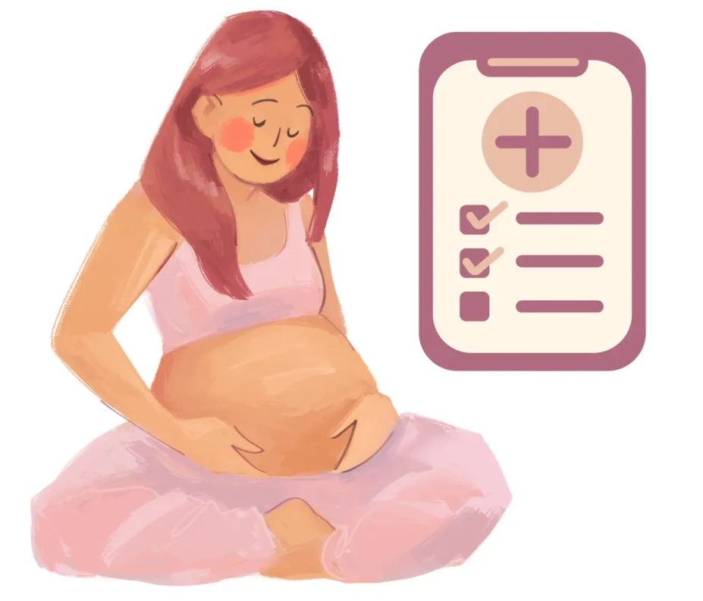
HOW TO USE THIS GUIDE
This user guide contains learning materials to support the health of pregnant mothers and infants. If you are pregnant now (or have been pregnant in the last year) and have any of the symptoms listed in this user guide, please seek medical care immediately.

Slide 3
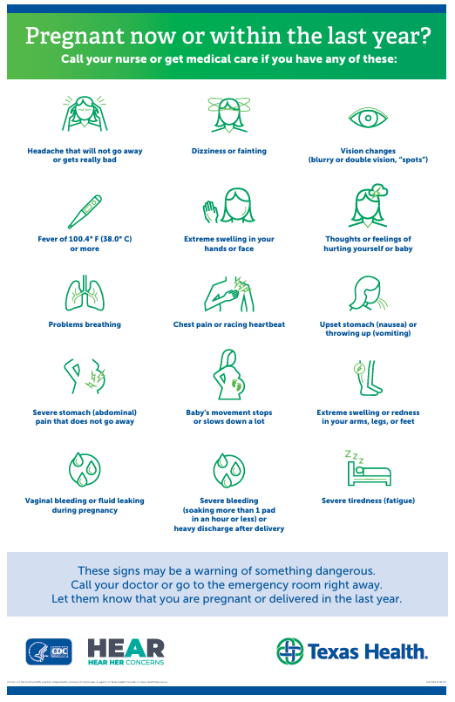

Slide 4
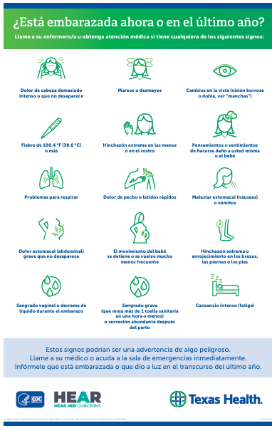

Slide 5
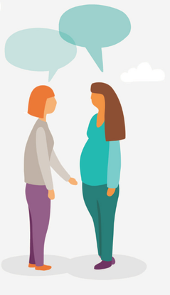
THEIR VOICES, THEIR STORIES
"I really want women to be aware, to know if they're at risk, to have a plan in place, to not be intimidated in doctor's offices, and to be heard.“
Hear Her Concerns
To learn more about
Personal Stories of Pregnancy-Related Complications
please click the link below:
https://www.cdc.gov/hearher/personal-stories/index.html

Slide 6
REFERENCES
Centers for Disease Control and Prevention Division of Reproductive Health. Diabetes Awareness Month. https://x.com/CDC_DRH/status/1724112922530476491
Centers for Disease Control and Prevention. (2024). Maternal mortality prevention. https://www.cdc.gov/maternal-mortality/preventing-pregnancy-related-deaths/index.html#:~:text=More%20than%2080%25%20of%20pregnancy%2Drelated%20deaths%20are%20preventable
Centers for Disease Control and Prevention Hear Her Campaign. (2024). Hear personal stories of pregnancy-related complications. https://www.cdc.gov/hearher/personal-stories/index.html
Creative Commons. (n.d.) https://creativecommons.org/licenses/by-nc/3.0/

