Slide 1


Data Management & Analysis
Why is it important?

Slide 2
This document is marked with a dated date and speaks only as of that dated date. Readers are cautioned not to assume that any information has been updated beyond the dated date except as to any portion of the document that expressly states that it constitutes an update concerning specific recent events occurring after the dated date of the document. Any information contained in the portion of the document indicated to concern recent events speaks only as of its date. TEXAS HEALTH RESOURCES (“THR”) expressly disclaims any duty to provide an update of any information contained in this document. The information contained in this document may include "forward looking statements" by using forward-looking words such as "may," "will," "should," "expects," "believes," "anticipates," "estimates," or others. You are cautioned that forward-looking statements are subject to a variety of uncertainties that could cause actual results to differ from the projected results. Those risks and uncertainties include general economic and business conditions, receipt of funding grants, and various other factors which are beyond our control. Because we cannot predict all factors that may affect future decisions, actions, events, or financial circumstances, what actually happens may be different from what THR includes in forward-looking statements. Information contained in the presentation is confidential and proprietary and its use is expressly limited to the S&P Global Ratings’ update presentation.
INFORMATION CONTAINED IN THE PRESENTATION CAN NOT BE USED OR DISTRIBUTED TO ANY THIRD PARTY OR USED IN ANY REPORT WITHOUT THE WRITTEN CONSENT OF TEXAS HEALTH RESOURCES.

Slide 3

Data Management
Data Management consists of:
  Data Collection:
  Gathering information from various sources, including patient records, laboratory results, and clinical observations.
  Data Entry:
  Inputting data into a database or electronic data capture (EDC) system.
  Data Validation:
  Ensuring data accuracy and consistency by implementing checks and quality control measures.
  Data Storage:
  Securely storing data in a manner that is easily accessible for analysis and audit trails.
  Data Cleaning:
  Removing errors, inconsistencies and missing data to improve data quality.
  Data Governance:
  Establishing clear protocols for data usage, access, and security to maintain data integrity.
  Audit Trail:
  Maintaining a record of all data modifications and access to ensure accountability and traceability.

Slide 4

Data Analysis
Data Analysis consists of:
  Data Transformation:
  Preparing data for analysis by converting it into a suitable format for statistical modeling.
  Statistical Analysis:
  Using statistical techniques to analyze data, identify patterns, and test hypotheses.
  Data Interpretation:
  Drawing meaningful conclusions from the analysis results, considering statistical significance and clinical relevance.
  Reporting:
  Clearly and comprehensively reporting the findings of the analysis in a format suitable for publication or presentation.

Slide 5
Why is Data Management & Analysis Important?
Ensures Quality & Integrity
Ensures Accurate Analysis & Reporting
Provides Regulatory Compliance
Provides Patient Safety
Maintains Ethical Standards
Drives Scientific Progress

Slide 6

Examples of Data Management Tools:
Oracle Clinical Software
CLINTRIAL Software
MACRO Software
RAVE Software
eClinical Suite Software
OpenClinica
openCDMS
TrialDB
PhOSCo

Slide 7
Regulations, Guidelines, and Standards
Electronic records must comply with a Code of Federal Regulations (CFR), 21 CFR Part 11.
Procedures and controls should be in place to comply.
Good Clinical Data Management Practices (GCDMP) – published by Society for Clinical Data Management (SCDM).
Standards for acquisition, exchange, submission and archiving of clinical research data and metadata can be found with the non-profit organization – Clinical Data Interchange Standards Consortium (CDISC).
http://www.cdisc.org/
https://pmc.ncbi.nlm.nih.gov/articles/PMC3326906/
Data Management in Clinical Research: An Overview, NIH, 2012 Mar-Apr, https://pmc.ncbi.nlm.nih.gov/articles/PMC3326906/, Accessed 12 May 2025.

Slide 8
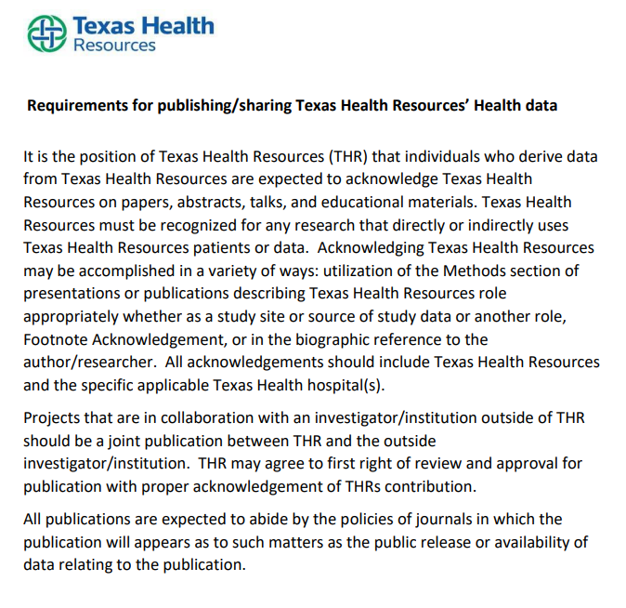
THR Requirements for Publishing/Sharing Data

Slide 9

Research Data Requests
If you need the THR Data Analytics team to assist with data pulls from the THR electronic medical records, please contact Research Administration

